Slide 1
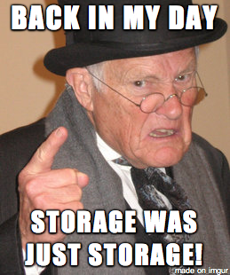
dCache storage for Tropomi
Onno Zweers & Natalie Danezi - 2018-12-19 - v1.2

Slide 2
Grid service components
Compute: Gina @SURFsara (6500 cores, 8GB RAM/core), Nikhef (4500 cores) or international clusters
Storage: dCache, local (SSD), ..
High bandwidth network: internal, GEANT, ..
Pilot Job Framework: PiCaS, Dirac, Rucio, PanDA, ..
Workflows: Airflow, CWL, ..
Grid-stack:
UI: generic, dedicated
WMS: gLite, Dirac, ..
VOMS: VO or VO groups for authorisation
Creamce: Torque, Slurm, ..
Authentication: X509, RCauth, (username/password)
Software: CVMFS, Singularity, tar with job, ..

Slide 3
Tropomi Grid implementation
Storage:
E-infra grant: 70TiB tape - 15TiB writetapepool - 5TiB readtapepool
Current alloc: 155TiB tape - 15TiB writetapepool - 95TiB readtapepool

Slide 4
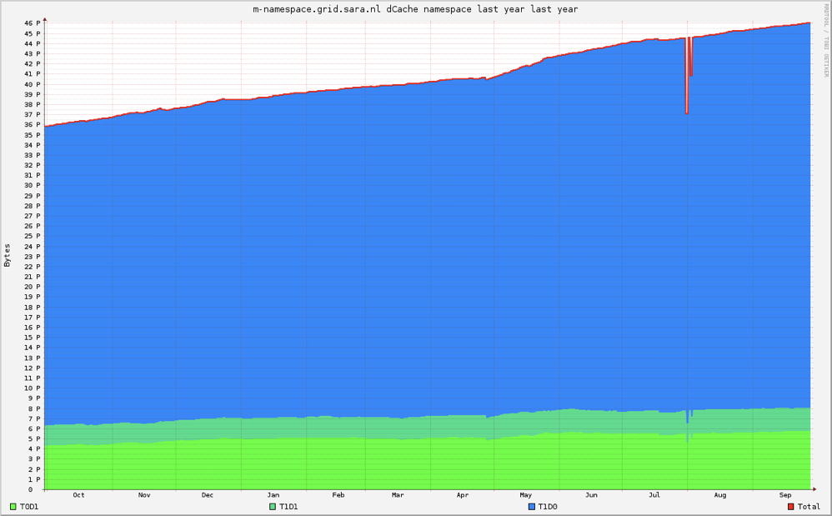
Grid storage
49PB of data on disk and tape
Statistics last year:
117PB read, 22PB written
7PB stored to tape, 8PB restored from tape
On average 350TB is read every day, peak 1.3PB
500 years of HD video
600 km of stacked cdroms

Slide 5
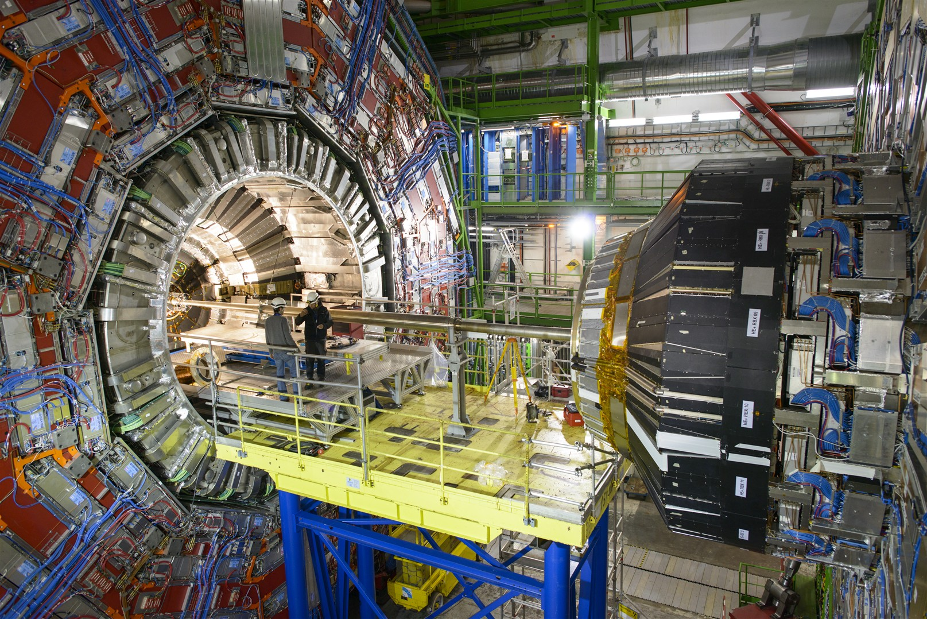
CERN, WLCG (World wide Large hadron collider Computing Grid)

Slide 6
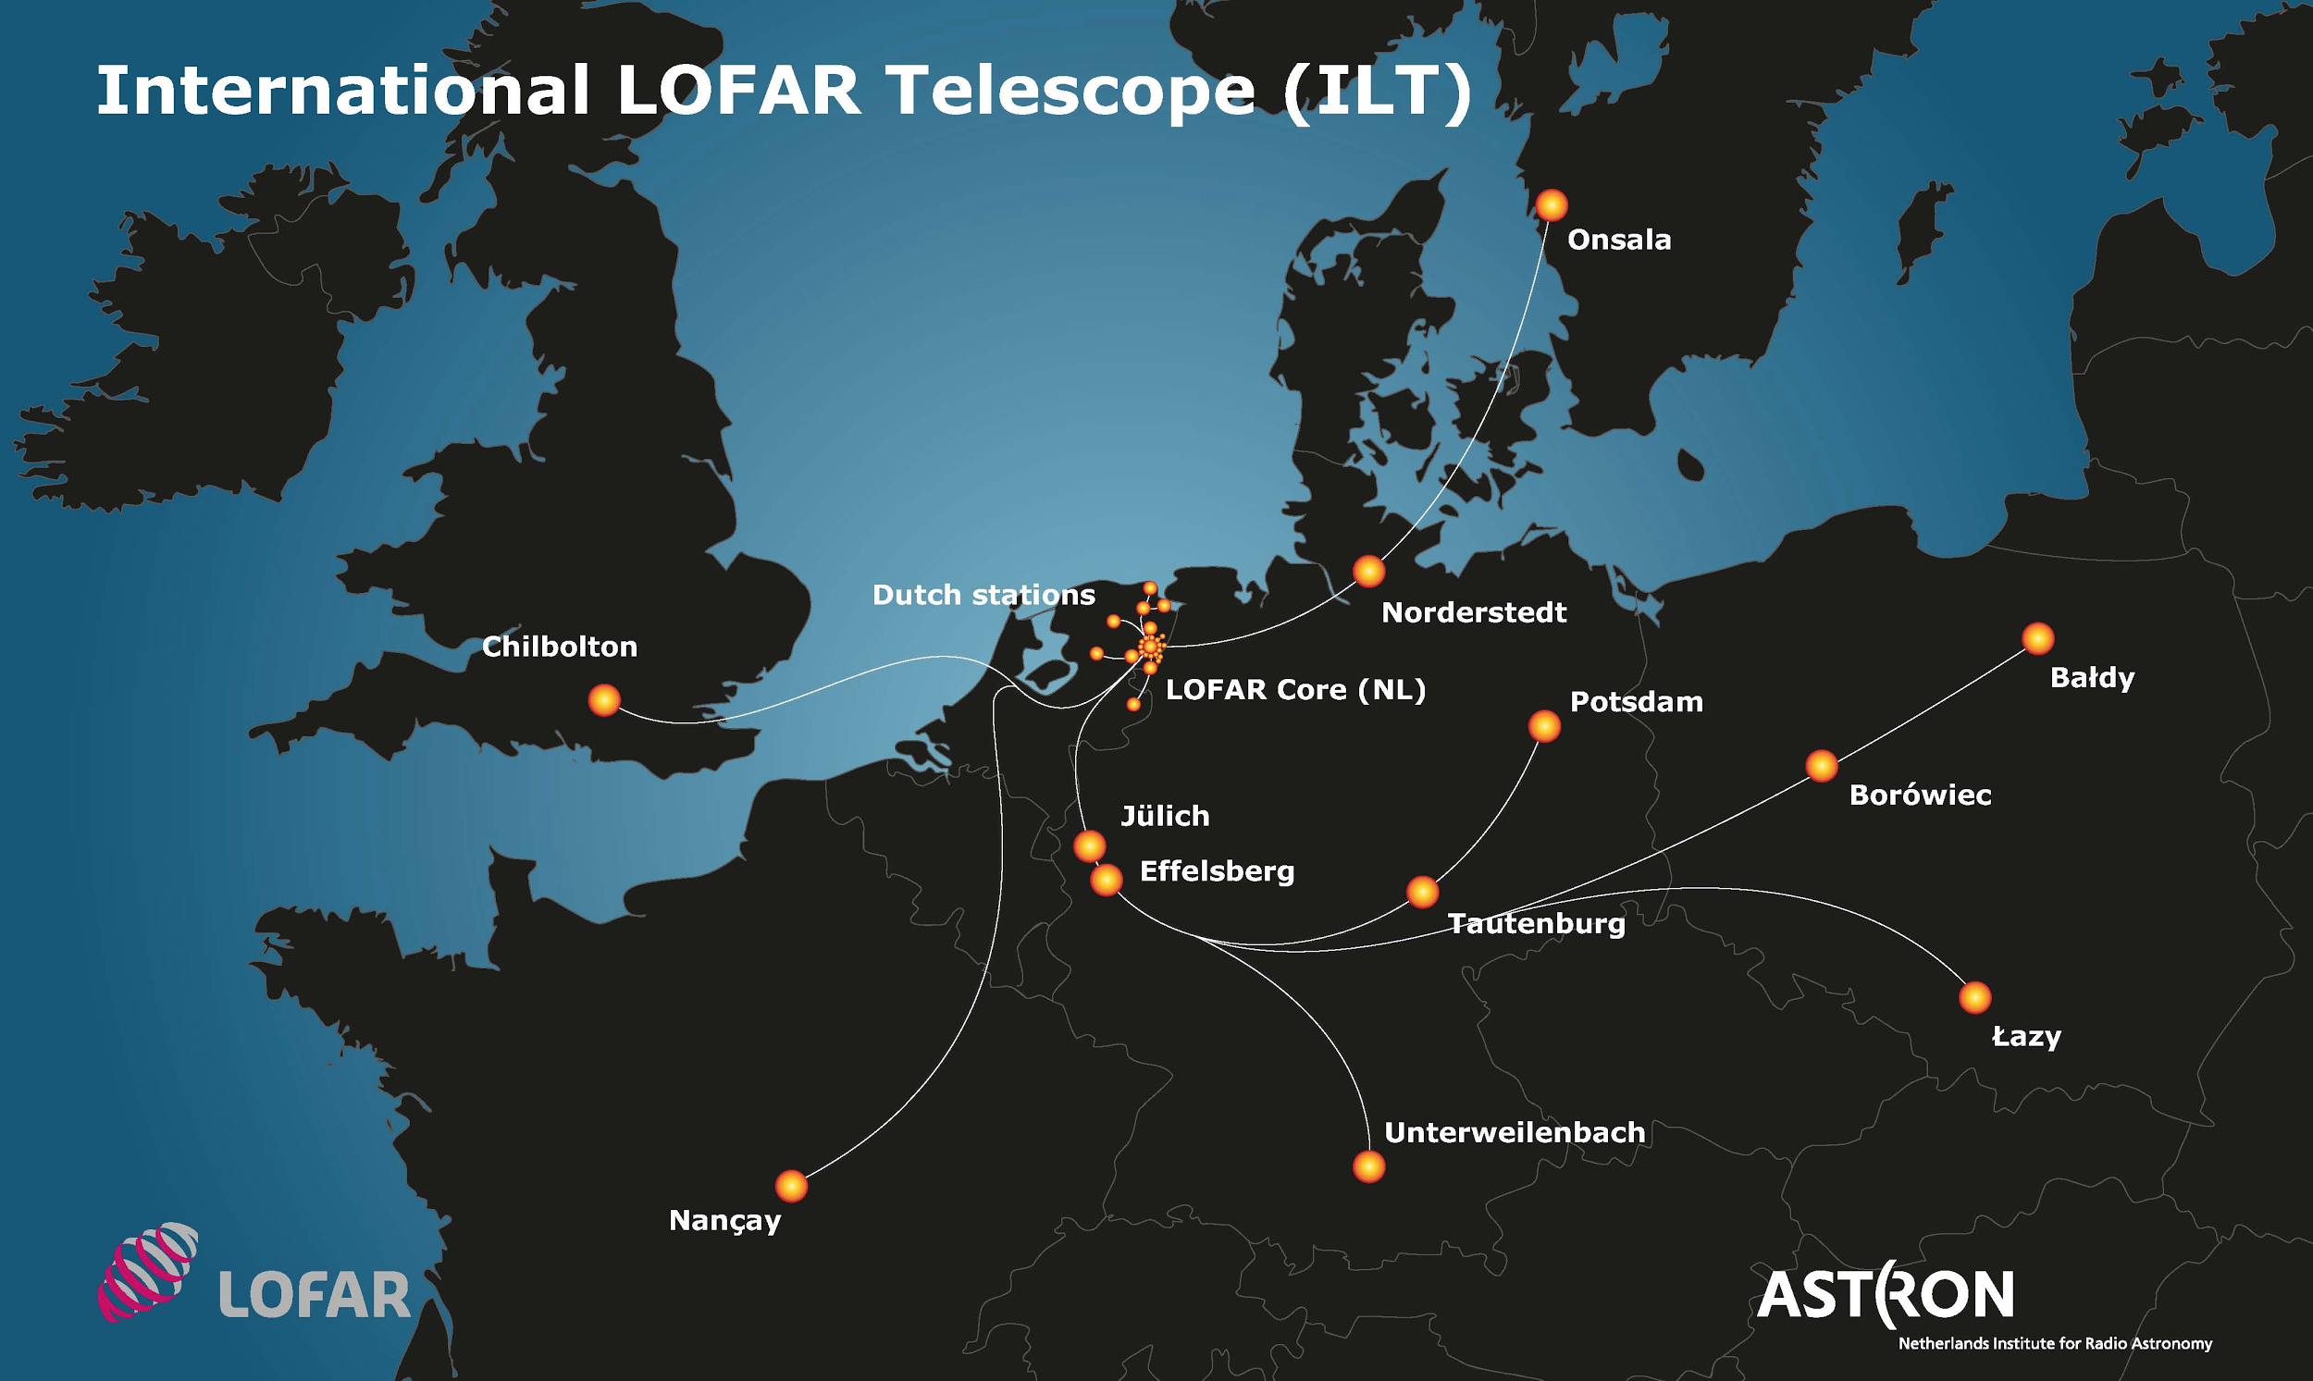
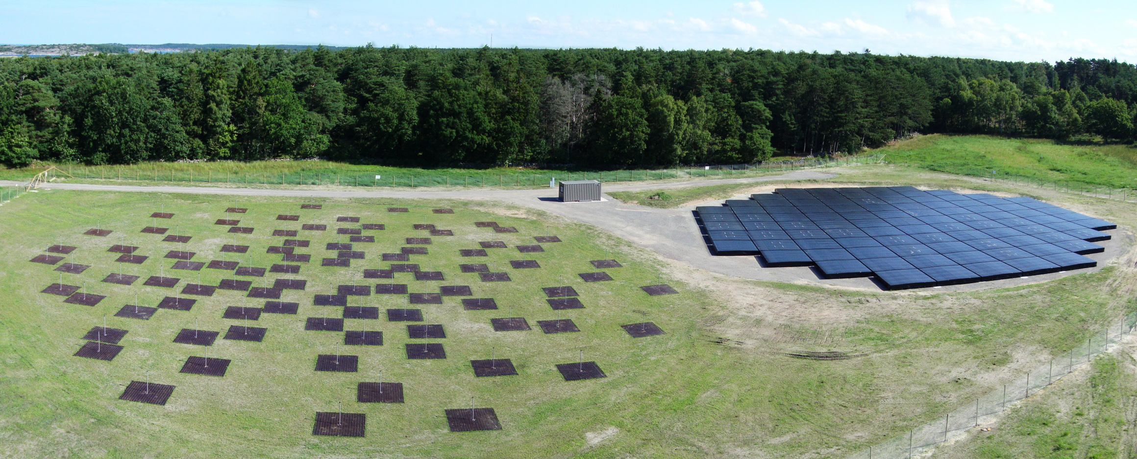
LOFAR (radio astronomy) Long Term Archive
23 petabyte at SURFsara, 10 petabyte at other sites. Largest astronomy archive in the world

Slide 7

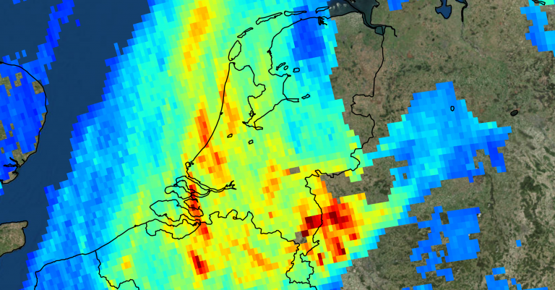
Tropomi

Slide 8


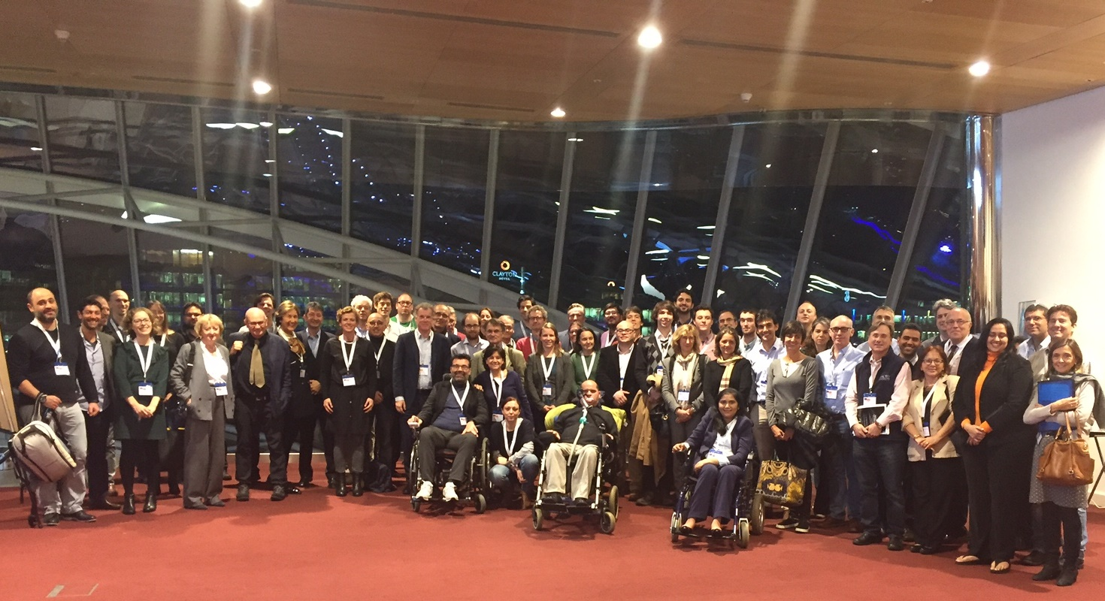
ALS Project MinE

Slide 9

What is dCache?
Distributed storage software
Seemless integration with tape archives
Data is immutable (no updating or appending yet)
Java coded, open source https://github.com/dCache
Protocols: SRM, GridFTP, WebDAV, NFS, GSIdCap, Xroot
Pools configuration
T0D1 = disk only - one copy on disk only
T2D1 = disk & tape - two copies on tape and one on disk at the same time
T2D0 (or T1D0) = tape only, only two copies on tape and possibly a cached copy on disk

Slide 10
Front End Storage setup
Head nodes
Namespace (PostgresQL database with WAL archiving replication)
Space Manager
SRM (PostgresQL database with WAL)
...
Pool nodes
~ 130 file servers
Some servers have 380 TB, most ~ 80TB
RAID 60
often software RAID over HW RAID 6 arrays
Network
Excellent connectivity with Gina (Grid compute) cluster
IPv6 dual stack
Speed record: 1.3 petabyte in a day, 55 GB/s peak
Tape
DMF system (Data Preservation Services group)
2 libraries in separate datacenters

Slide 11
SRM door
Meta-protocol: redirects to GridFTP doors for actual file transfers.
Load balancing
File status (online/nearline, availability, size etc)
Bring online (stage)
Pin file (lock its cache copy on disk for a period)
Unpin file (unlock it so that the cached copy may be purged)
Client tools: srm*, gfal*
srm.grid.sara.nl:8443 (1 single door)

Slide 12
GridFTP doors
High speed because of multiple threads
Optimized for long distances
No data encryption (yet)
Clients
globus-url-copy
Gfal
UberFTP copy may destroy data!
Third party clients
Globus Online
FTS
gridftp.grid.surfsara.nl DNS round robin

Slide 13
WebDAV doors
Authentications
X509 certificates
Username/password
Macaroons (authentication tokens for sharing data)
Can use port 443, bypassing firewall misery
Redirects
On: load balancing
Off: data encryption
webdav.grid.surfsara.nl DNS round robin

Slide 14
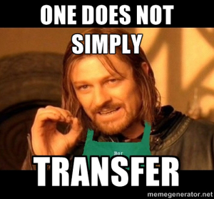
Clients
srm*
globus-url-copy
gfal* CLI and Python lib
web browsers (via webdav)
wget, curl (webdav)
Cyberduck (webdav)
Rclone (webdav)
FTS (third party file transfers)
Globus Online (third party file transfers)
UberFTP (careful with overwrite!)
…
http://doc.grid.surfsara.nl/en/latest/Pages/Advanced/grid_storage.html

Slide 15

Staging
Most files are on tape (NEARLINE)
To read them, they must be on disk (ONLINE or ONLINE_AND_NEARLINE)
Copying from tape to disk = staging = bringing online
Staging in advance is efficient (because parallel)
Reading files that are not staged?
dCache will queue a stage request
Could take 2 minutes or 2 days
Client will wait until file is staged or until timeout
Waste of CPU cycles, transfers slots and tape robot operations
Operations
Pin file - lock its cache copy on disk for a period
Unpin file - unlock it so that the cached copy may be purged
Staged copies will be removed when space is needed (unless they are pinned)
http://doc.grid.surfsara.nl/en/latest/Pages/Advanced/grid_storage.html#staging-files

Slide 16
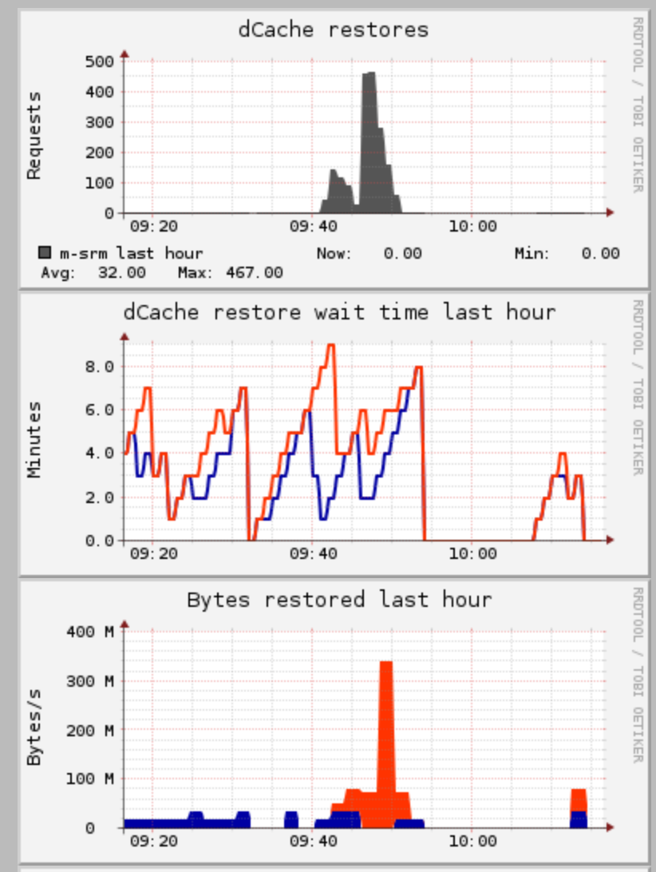
Example
One user (blue in the bottom graph) stages in small portions, and has to wait a long time for each file
The other user (red in the bottom graph) stages everyting at once and gets a high throughput

Slide 17
Tape flow
Certain dirs (.../Tape/…) are connected to tape pools
Files written here are stored on disk first, in a tape write pool, and marked "precious".
dCache will put a "put" request in its tape write queue.
When ready, dCache will call a script (dmfcp.sh) which will copy the file to our tape system.
When tape checksum is OK, dCache will mark its copy on disk "cached".
Cached files will remain cached on disk until space is full.
Least recently used files are purged first.
Precious files are never purged.
When reading, dCache will serve a cached copy if available
If no cached copy available, dCache will queue a stage request. File will be staged in a tape read or stage pool.
Diagram next page!

Slide 18
disk write
poolgroup
.../disk/...
tape write
poolgroup
tape
2 replicas
.../tape/…
tape read
poolgroup
staging

Slide 19
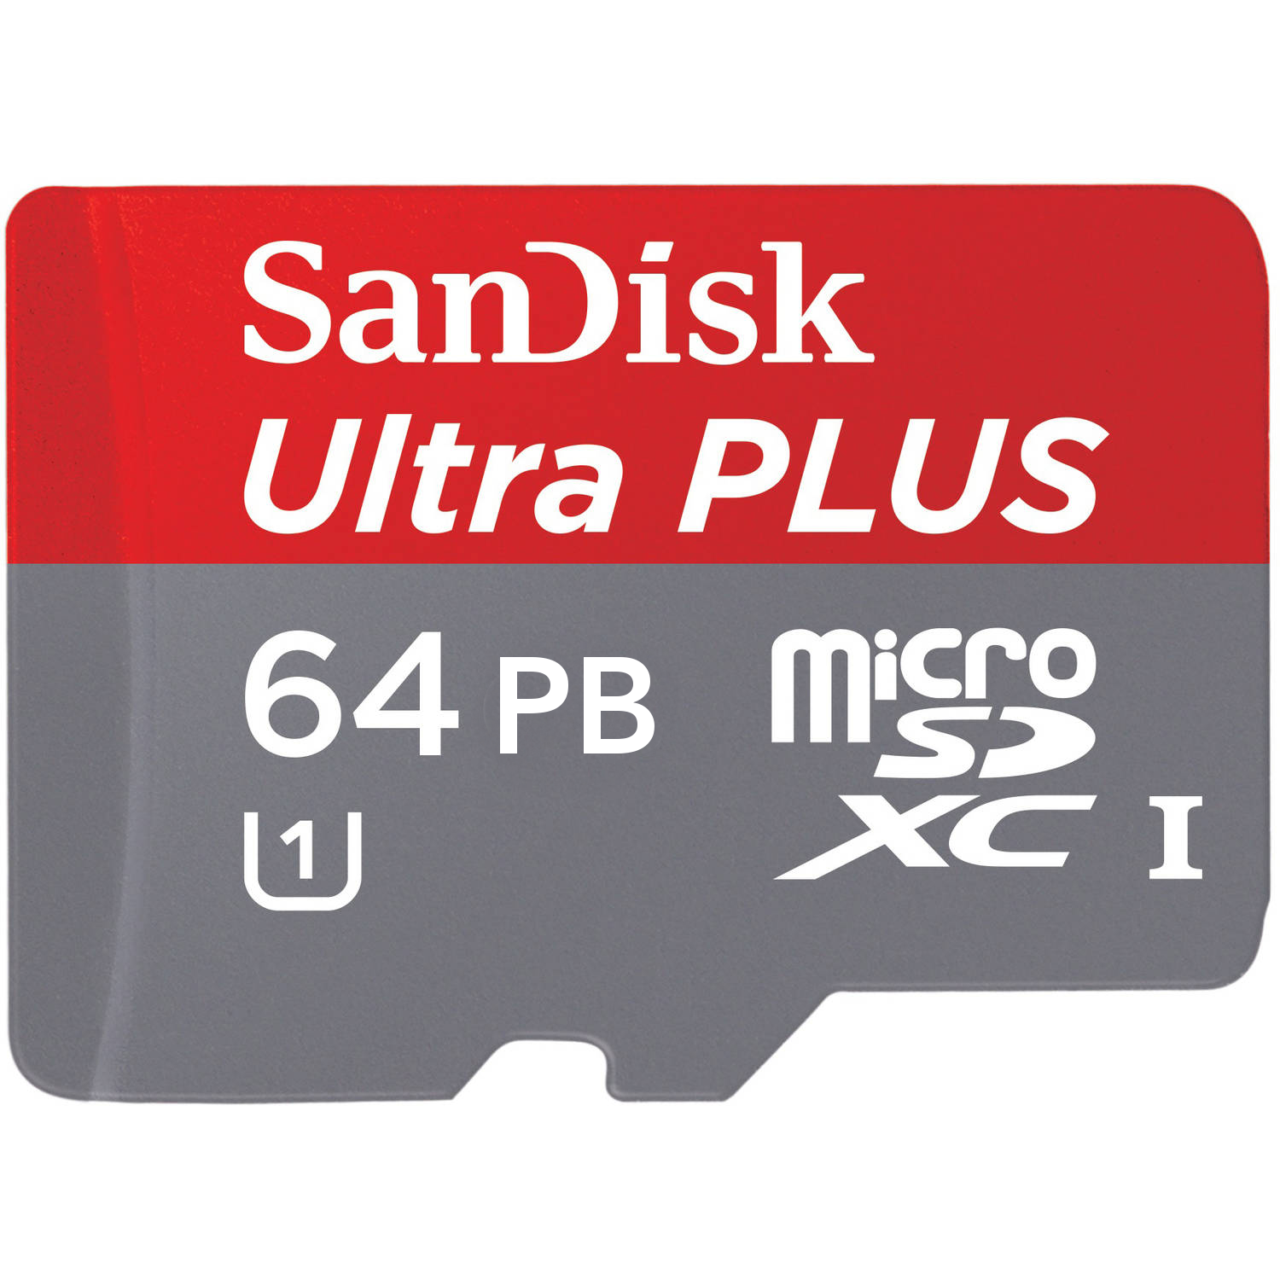
Future plans
dCache 4
dCache View portal: easy staging and sharing
REST API
NFS improvements
MD5 checksums beside Adler32
dCache 5
Mutable files
SciTokens
High availability in dCache
Better redundancy with CEPH
More doors
Better network redundancy
Multiple SRM doors
Gradually moving to grid.surfsara.nl
srm.grid.sara.nl still hardcoded everywhere: will maintain it

